Slide 1

Ohmfinder
Presented by
SimsalaBOM

Slide 2

BOM in.
Better Components Out.

Slide 3

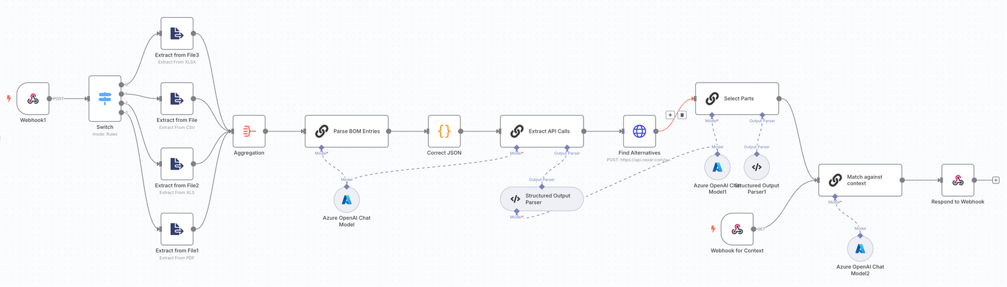
Solution
Structure the BOM to be read and retrieve alternatives parts.
Organize the parts, offer a choice of parts and recommendations.

Slide 4
-
n8n data flow
real time collaboration is a missing feature
structuring inputs and outputs
Missing domain knowledge
Challenges

Slide 5

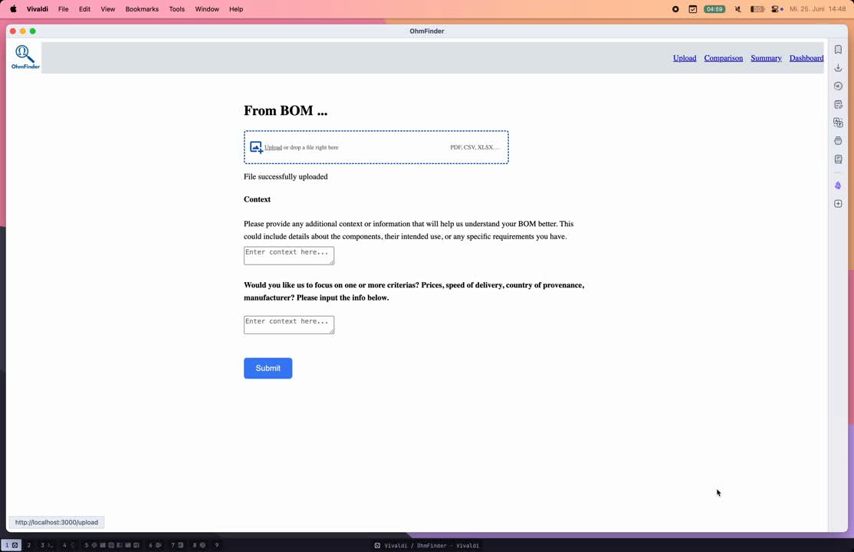


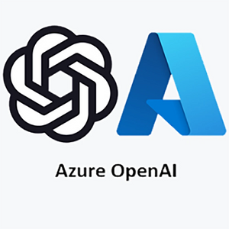

Thynk Unlimited
Home
About
Content
Others
TechStack

Slide 7
Thynk Unlimited
Home
About
Content
Others
Customers: EMS service providers, OEMs in automotive, industrial electronics, design houses
Market: global EMS market (600 billion USD, 50% of projects suffers from parts shortages), digital BOM management software growing > 12% p.a.
Value proposition: Cost and delivery risk reduction through AI-supported search and transparent basis for decision-making
Business Plan
Purchasing made easy

Slide 8
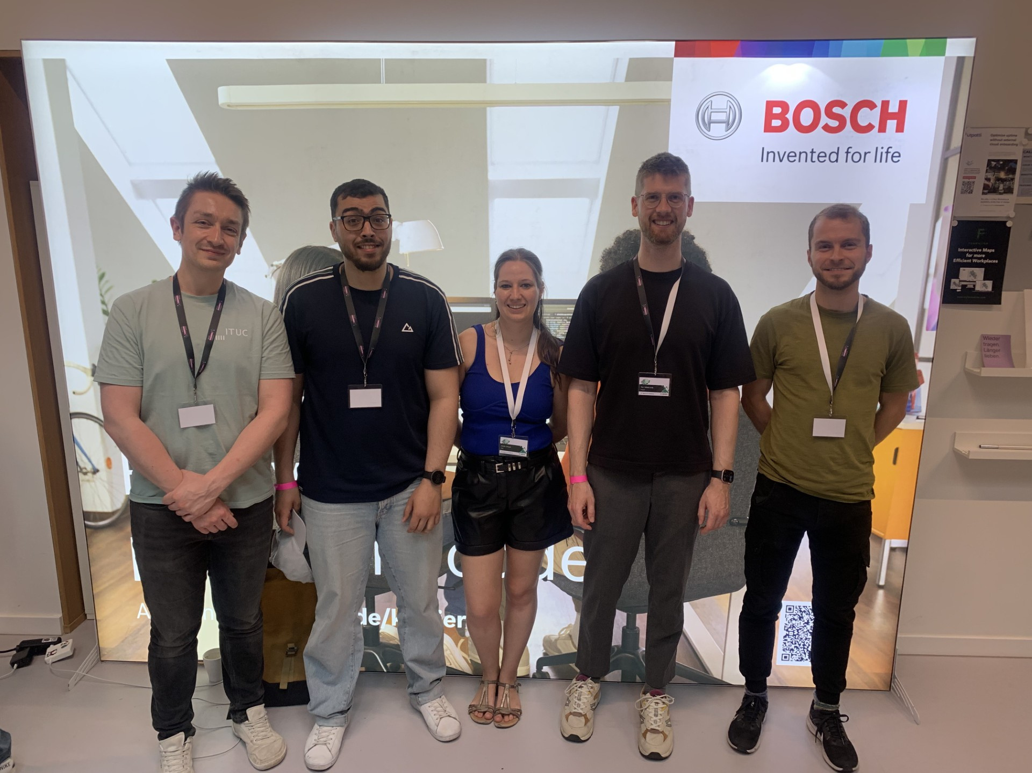
Team
Working Together in Code

